Slide 1
HUBZone Contractors National Council

Slide 2
WELCOME
Get ready to elevate your social media presence and showcase your excitement for the upcoming event. Whether you're an attendee, exhibitor, or speaker, this kit has everything you need to make a splash on social media and connect with the HUBZone community. Let's dive in!
The HUBZone Conference is the premier event for innovators, entrepreneurs, and leaders in the HUBZone community. From insightful panel discussions to dynamic networking opportunities, this conference is your gateway to success in the HUBZone world. Get ready to learn, connect, and thrive!
HUBZone Contractors National Council

Slide 3
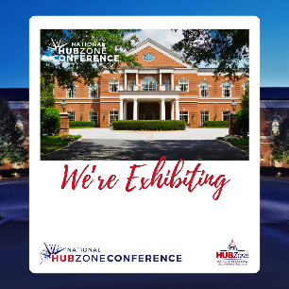
EXHIBITORS
Exhibitor Graphics: Attract attention to your booth with professional graphics highlighting your products, services, and special offers. Place your logo in the blank area.
HUBZone Contractors National Council

Slide 4
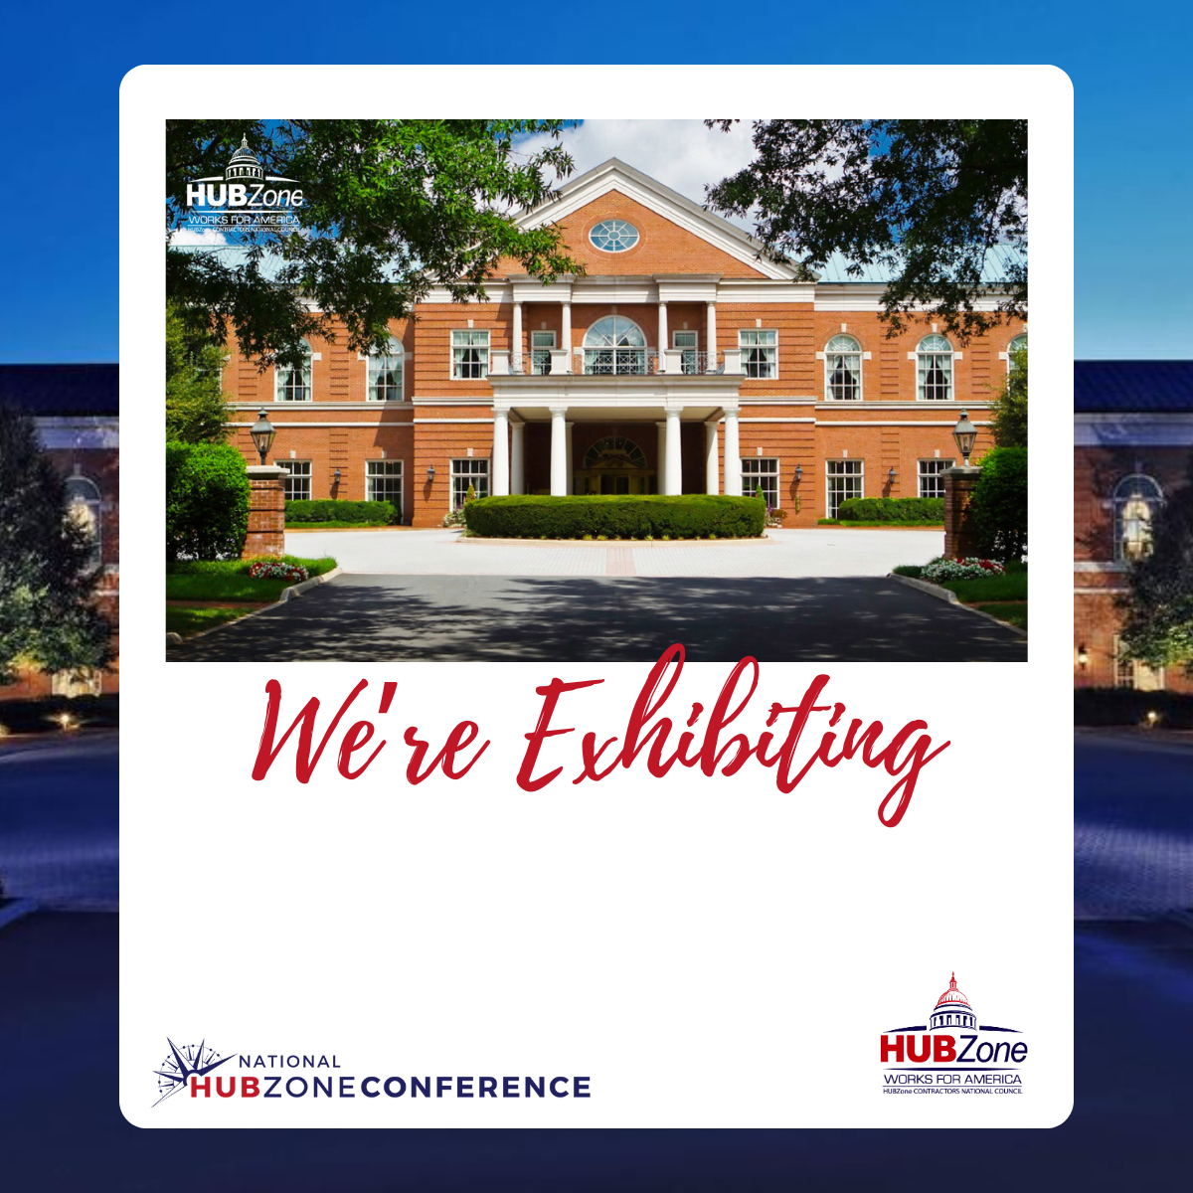

Slide 5
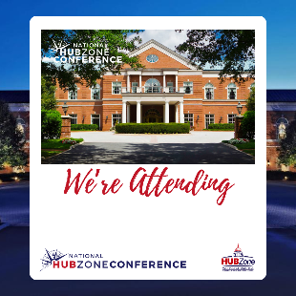
ATTENDEE
Attendee Graphics: Stand out in the crowd with custom-designed banners, cover photos, and profile picture frames that showcase your excitement for the conference. Place your logo in the blank area.
HUBZone Contractors National Council

Slide 7
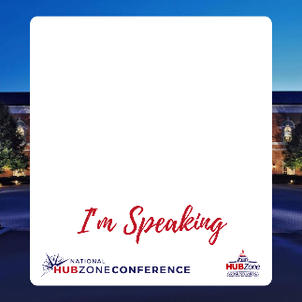
SPEAKER
Speaker Graphics: Announce your speaking engagement in style with attention-grabbing visuals that highlight your expertise and session details. Place your headshot photo in the blank space.
HUBZone Contractors National Council

Slide 9
ADDITIONAL GRAPHIC
Additional Graphics: Show your support for the HUBZone Conference and the HUBZone Council with our official event logos. Use them proudly in your social media posts to let your audience know you're part of the action.
HUBZone Contractors National Council

Slide 10
HASHTAGS & HANDLES
Join the conversation and amplify your message with our official event hashtags:
#HZConf24
#HUBZoneConf24
Connect with us on social media and stay up-to-date with all the latest conference news and updates:
Facebook: @ HUBZone Contractors National Council
Twitter/X: @HUBZoneCouncil
Instagram: @ hubzone_council
LinkedIn: @ HUBZone Contractors National Council and @Michelle Burnett
HUBZone Contractors National Council

Slide 11
CAPTIONS
Need some inspiration for your social media posts? Check out our collection of catchy captions and watch your engagement soar:
“Join [company name] at the 2024 NationalHUBZone Conference, happening July 23 through the 25th. Discover insightful educational sessions, valuable networking opportunities, and essential resources for small businesses. Visit us in the exhibit hall at Booth [booth number]. Learn more at [link]. #HZConf24 #HUBZoneConf24
"Honored to be speaking at the #HUBZoneConference and sharing insights on entrepreneurship in underserved communities. #HUBZoneConf24 "
“Thrilled about the upcoming 2024 National HUBZone Conference in July! Looking forward to a myriad of networking opportunities, enriching training/ workshops, two full days of fruitful matchmaking, and so much more. Learn more at [Link]. #HZConf24 #HUBZoneConf24 ”
HUBZone Contractors National Council

Slide 12
IMPORTANT LINKS
Conference Website:
https://hubzonecouncil.org/2024-National-HUBZone-Conference
Registration:
https://events.american-tradeshow.com/hubzone24
Room Block:
https://book.passkey.com/e/50754564
HUBZone Contractors National Council

Slide 13
CONTACT US
If you have any questions or concerns, feel free to email us at:
events@hubzonecouncil.org
HUBZone Contractors National Council

